Slide 1
Ruby Training: Expressive Scenarios
Matthew Eakin, Manager
Managed Testing Practice
Sogeti, USA
Matthew.Eakin@us.sogeti.com

Slide 2
Agenda
Cucumber Scenarios
Scenario Outlines
Background
Matt’s 2012 Marathon Running Plan Project
Putting the Answers in your Scenarios
Reading the tables
More tables
Finding the best time
Did I qualify for the 2012 Boston Marathon?

Slide 3
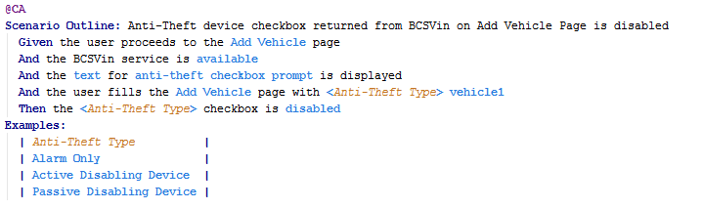
Scenario Outlines
Cucumber allows you to write one Gherkin Script but execute it multiple times
Use keywords to tie to an example table
Great if you have several TestCases where only variables change
Example:

Slide 4
Backgrounds
Cucumber allows you to write part of a script to be executed before each Scenario in the Feature File
Similar to a BEFORE hook
Can be very useful if all Scenarios have same Given step
Syntax:
Background: navigate to Add Vehicle page
Given the user navigates to the Add Vehicle page
Scenario: find local agent
When the user clicks find a local agent
Then the application navigates to the Find Agent Page
Scenario: goto PNI page
When the user clicks Get Quote button
Then the application navigates to the PNI page
The Background will execute before each Scenario

Slide 5
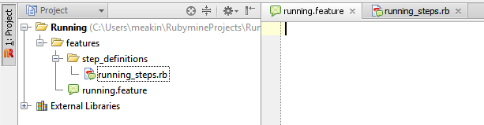
Matt’s 2012 Running Plan, kind of
Create a new Project: Running
Create the base cucumber structure
Feature name: running.feature
Step definition file name: running_steps.rb
Should look like this:

Slide 6
Acceptance Criteria
Acceptance Criteria: represents an agreement between the stakeholder and delivery team
Did I meet my goal for each race?
Did I qualify for the Boston Marathon?
My Qualifying Time: 3:30
Race Date | Location City | Loc State | Race | Goal Time
2012-06-05 | San Diego | CA | Dodge Rock 'n' Roll Marathon | 4:00:00
2012-07-09 | Boone | NC | Grandfather Mountain Marathon | 5:00:00
2012-08-14 | Saint John | NB | Tim Hortons Marathon by the Sea | 3:50:00
2012-09-17 | Dayton | OH | Air Force Marathon | 3:40:00
2012-10-16 | Columbus | OH | Nationwide Better Health Columbus Marathon | 3:29:00
2012-11-06 | New York City | NY | ING New York City Marathon | 3:29:00
2012-12-11 | Honololu | HI | Honolulu Marathon | 5:00:00
2013-01-08 | Orlando | FL | Disney World Marathon | 5:00:00

Slide 7
Gherkin Scripts
Gherkin Scripts: connects the human concept of cause and effect to the software concept of input/process/output.
Given – indicates something that we accept to be true in a scenario
When – indicates the event in a scenario
Then – indicates an expected outcome
Example we will be using for today (do not build your steps yet)
Given I set a goal for each Race I will run
When I run each race
Then each race will be considered a success if I meet or break each goal time
And I qualify for the Boston Marathon
But what Races am I going to run in? And what is my goal for each Race?

Slide 8
Using Tables in your Gherkin Script
Cucumber allows you to put a table directly in your Gherkin Script:
Given I set a goal for each Race I will run
|Race Date |Location City|Loc State| Race |Goal Time |
| 2012-10-16 |Columbus |OH |Nationwide Columbus Marathon|3:29:00 |
| 2012-12-11 |Honololu |HI |Honolulu Marathon |4:00:00 |
| 2013-01-08 |Orlando |FL |Disney World Marathon |4:00:00 |
Each line in the table must start and end with a pipe “|”
The pipes do not need to line-up; but you can make them using ctrl-alt-l
You must have a field in the line for each value
But each field doesn’t need to have a value

Slide 9
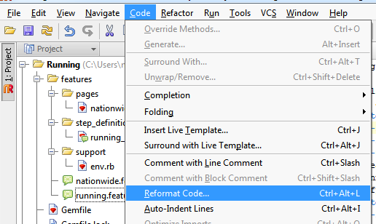
Another Table
To track our Actual Times we will also use a table that we put into the Gherkin script
When I run each race
| Race Date |Location City|Loc State| Race |Actual Time |
| 2011-10-16|Columbus |OH |Nationwide Columbus Marathon|3:19:27 |
| 2011-12-11|Honololu |HI |Honolulu Marathon |5:01:00 |
| 2012-01-08|Orlando |FL |Disney World Marathon |3:57:25 |
To align everything go to Code -> Reformat Code… Or hit ctrl+alt+L

Slide 10
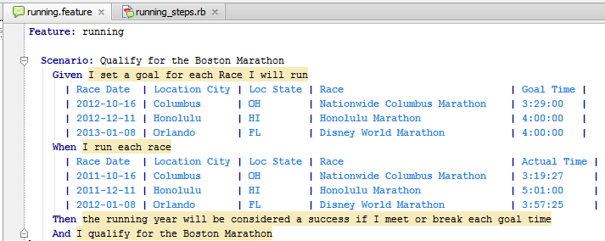
Initial Set-up
Your .feature file should now look like this…
Go ahead and create all of the step definitions for this Scenario

Slide 11
Tables in your steps file
Notice that Cucumber recognizes the table in your Gherkin script and adds it to the step:
Given /^I set a goal for each Race I will run$/ do |table|
# table is a Cucumber::Ast::Table
pending # express the regexp above with the code you wish you had
end
The “table” variable will always be the last variable passed
The “table” variable is a Hash (sometimes called an associative array)
The header row of your table will provide the hash “keys”; the rows will provide the “values”
This is called a key-value pair

Slide 12
Where to begin our code
Once the step definitions are created re-run the Scenario
The follow cucumber to our 1st code need
At this point all we are trying to do is
Iterate through the race goal times table
Capture my race goal times for later use
The following code should do the trick:
Given /^I set a goal for each Race I will run$/ do |table|
@goals_array = Array.new
table.hashes.each do |hash|
#puts hash.inspect
@goals_array << hash
end
end
Iterate through the race goal times table
Capture my race goal times for later use

Slide 13

Our next “Red”
Re-run the Scenario and you should get…1 passed
Follow cucumber to our next code need..
At this point we are trying to
Iterate through the race actual times table
Capture my race actual times for later use
The following code should do the trick:
When /^I run each race$/ do |table|
@actuals_array = Array.new
table.hashes.each do |hash|
#puts hash.inspect
@actuals_array << hash
end
end
Iterate through the race actual times table
Capture my race actual times for later use

Slide 14
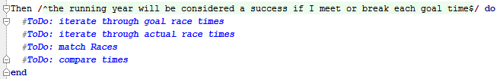
The Code we wish to write for the Then Step
In the Then Step we wish to write code to accomplish the following:
Go through each Race and extract the goal time for each Race
#ToDo: iterate through goal race times
Go through each Race and extract the actual time for that Race
#ToDo: iterate through actual race times
When the Race matches compare the goal time with the actual time
If actual time < goal time then SUCCESS
#ToDo: match Races
#ToDo: compare times

Slide 15
ToDo #1 – iterate through goal race times
To accomplish our 1st ToDo we need to iterate through the array which contains my race goals: @goals_array
Iterating through Arrays requires the each-do command:
Then /^each race will be considered a success if I meet or break each goal time$/ do
@goals_array.each do |goals_hash|
puts "#{goals_hash["Race"]}: #{goals_hash["Goal Time"]}"
end
#ToDo: iterate through actual race times
#ToDo: match Races
#ToDo: compare times
end
Run the Scenario and you should see all 3 Races and their Goal Time

Slide 16
ToDo #2 – iterate through actual race times
To accomplish our 2nd ToDo we need to iterate through the array which contains my actual race times: @actuals_array
Iterating through Arrays requires the each-do command:
Then /^each race will be considered a success if I meet or break each goal time$/ do
@goals_array.each do |goals_hash|
puts "#{goals_hash["Race"]}: #{goals_hash["Goal Time"]}"
@actuals_array.each do |actuals_hash|
puts "#{actuals_hash["Race"]}: #{actuals_hash["Actual Time"]}"
end
end
#ToDo: match Races
#ToDo: compare times
end
Again, run the Scenario and you should see Races and their Actual Times

Slide 17
ToDo #3 – Matching the Races
Next we need to check that the Race matches
This can be accomplished with an If-Then conditional:
Then /^each race will be considered a success if I meet or break each goal time$/ do
@goals_array.each do |goals_hash|
#puts "#{goals_hash["Race"]}: #{goals_hash["Goal Time"]}"
@actuals_array.each do |actuals_hash|
#puts "#{actuals_hash["Race"]}: #{actuals_hash["Actual Time"]}"
if actuals_hash["Race"].eql?(goals_hash["Race"]) then
puts "Goal Race #{goals_hash["Race"]} matches Actual Race #{actuals_hash["Race"]}"
end
end
end
#ToDo: compare times
end
Running the file should result in 3 output lines; each race matching
Note: line is now commented out
Note: line is now commented out

Slide 18
ToDo #4 – Comparing Results
Lastly, we need to compare the actual time with the goal time
Then /^each race will be considered a success if I meet or break each goal time$/ do
@goals_array.each do |goals_hash|
@actuals_array.each do |actuals_hash|
if actuals_hash["Race"].eql?(goals_hash["Race"]) then
#puts "Goal Race #{goals_hash["Race"]} matches Actual Race #{actuals_hash["Race"]}"
if actuals_hash["Actual Time"] < goals_hash["Goal Time"] then
puts "Goal met at the #{actuals_hash["Race"]}"
else
puts "Better luck next year at the #{actuals_hash["Race"]}"
end
end
end
end
end
Run the Scenario and you should see 2 “goals met” and 1 “better luck…”
Note: line is now commented out

Slide 19

The Code we wish to write for the Final Step
In the final Step we need to find out if I qualified for the Boston Marathon
To determine this we wish to write the following code
Determine if an Actual Time is my best time
#ToDo: Determine my best actual race time
Compare my best actual race time with my Boston Marathon Qualifying Time of 3:30
#ToDo: compare best actual race time with Boston Marathon Qualifying Time

Slide 20
ToDo #1 – Finding the best time
To determine our best time we are going to need to create an Instance variable early in code that we can use in the “And…” step
When /^…
@best_time = "9:00:00"
I am going to initialize it with a time that I know (hope) is much higher than any of my actual Race times

Slide 21
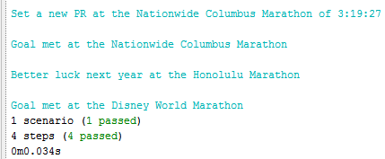
Determining my best time
As we go through the actual time hash in the When step we need to compare the actual time with the best time
If actual time < best time then actual becomes our new best
This updated When step should do the trick…
When /^I run each race$/ do |table|
@best_time = "9:00:00“ Run and you will get these results:
@actuals_array = Array.new
table.hashes.each do |hash|
#puts hash.inspect
@actuals_array << hash
if hash["Actual Time"] < @best_time
puts "Set a new PR at the #{hash["Race"]} of #{hash["Actual Time"]}"
@best_time = hash["Actual Time"]
end
end
end

Slide 22
ToDo #2 – Did I qualify for Boston?
We now know what the best time run during the year is (@best_time)
My time needed to qualify for Boston is 3:30:00
Our final comparison is simple:
And /^I qualify for the Boston Marathon$/ do
boston_goal = '3:30:00'
if @best_time < boston_goal then
puts "CONGRATULATIONS!!! You qualified for the Boston Marathon"
else
puts "Better luck trying to qualify for the Boston Marathon next year"
end
end
RUN THE .feature FILE and answer the question:
Did I qualify for the Boston Marathon?

Slide 23
Thank you

